Slide 1
Introduction
Arduino is an open-source electronic prototyping platform based on a simple i/o board and a development environment for writing software for the board.

Slide 2


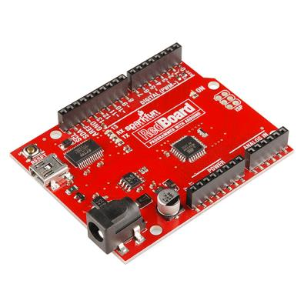
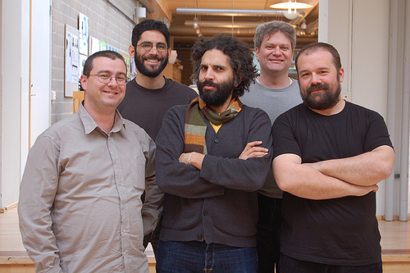
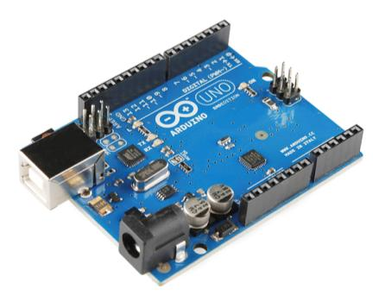
Arduino Board
“Strong Friend” Created in Ivrea, Italy
in 2005 by Massimo Banzi & David Cuartielles
Open Source Hardware
Processor
Coding is accessible & transferrable → (C++, Processing, java)

Slide 3
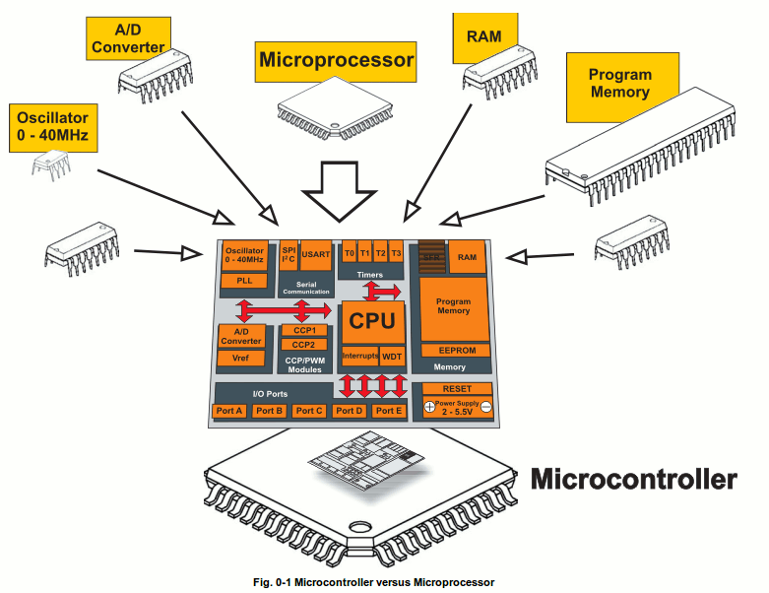
What is a Microcontroller
A small computer on a single chip
containing a processor, memory, and input/output
Typically "embedded" inside some device that they control
A microcontroller is often small and low cost
www.mikroe.com/chapters/view/1

Slide 4
Getting Started
SW Installation: Arduino (v.1.0+)
Drivers (FTDI)
Guide
Materials: Guide
Analog I/O, Digital I/O, Serial, & Fritzing handouts
Arduino CheatSheet

Slide 5
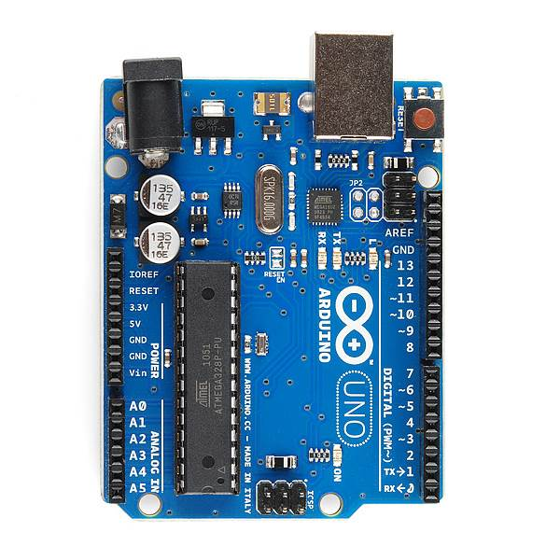
PWR IN
USB
(to Computer)
RESET
SCL\SDA
(I2C Bus)
POWER
5V / 3.3V / GND
Digital I\O
PWM(3, 5, 6, 9, 10, 11)
Analog INPUTS
Notes:
Look up analog ref

Slide 6
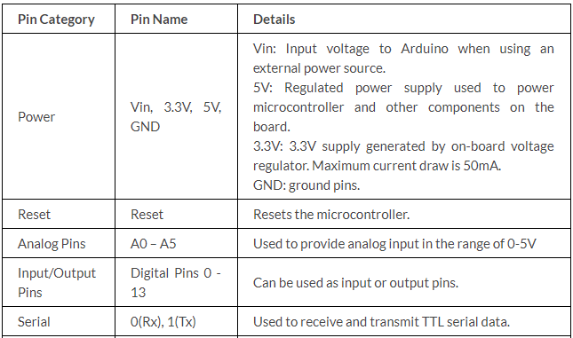
Pin Description

Slide 7
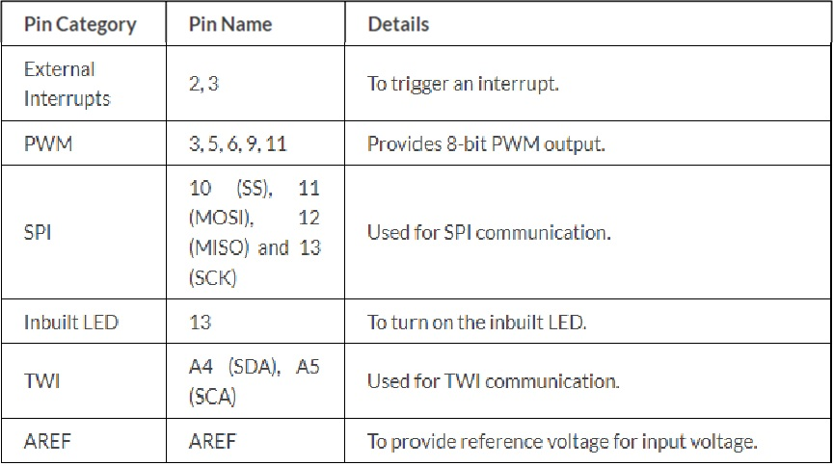
Pin Description

Slide 8
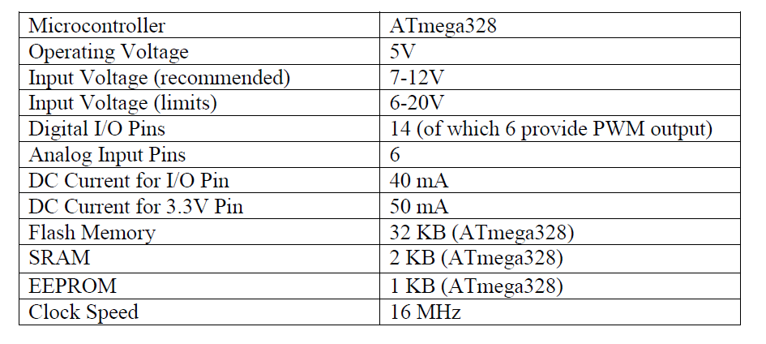
Technical Specs

Slide 9
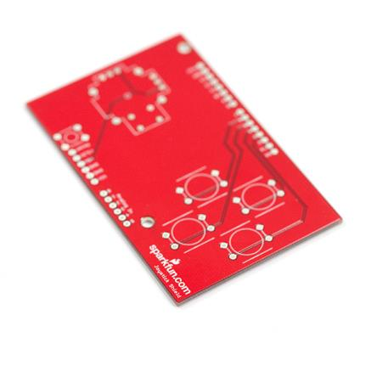
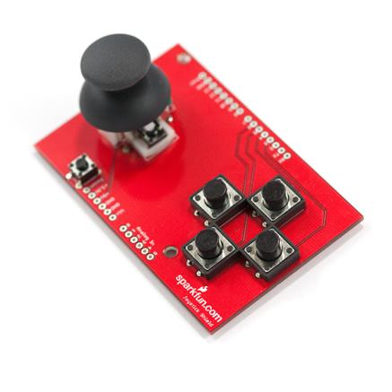
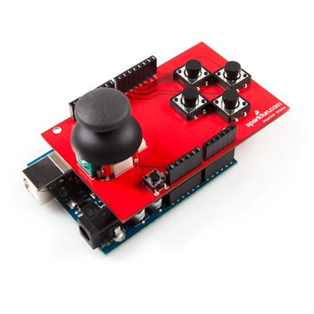
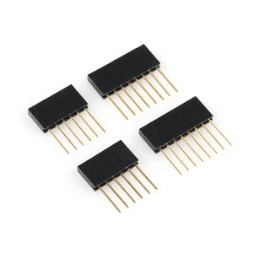
Arduino Shields
PCB
Built Shield
Inserted Shield

Slide 10
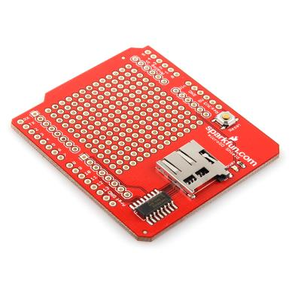
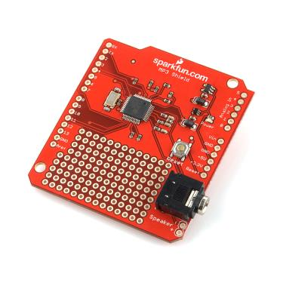
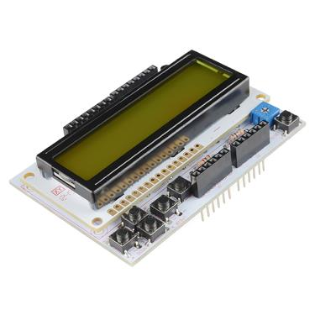
Arduino Shields
Micro SD
MP3 Trigger
LCD

Slide 11
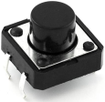
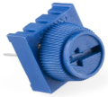
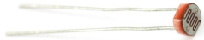
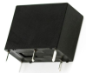
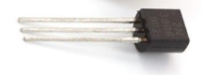
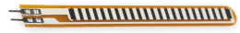
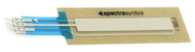

SIK Components (SparkFun Inventor Kit)
Name | Image | Type | Function | Notes
Push Button |  | Digital Input | Switch - Closes or opens circuit | Polarized, needs resistor
Trim potentiometer |  | Analog Input | Variable resistor | Also called a Trimpot.
Photoresistor |  | Analog Input | Light Dependent Resistor (LDR) | Resistance varies with light.
Relay |  | Digital Output | Switch driven by a small signal | Used to control larger voltages
Temp Sensor |  | Analog Input | Temp Dependent Resistor
Flex Sensor |  | Analog Input | Variable resistor
Soft Trimpot |  | Analog Input | Variable resistor | Careful of shorts
RGB LED |  | Dig & Analog Output | 16,777,216 different colors | Ooh... So pretty.

Slide 12
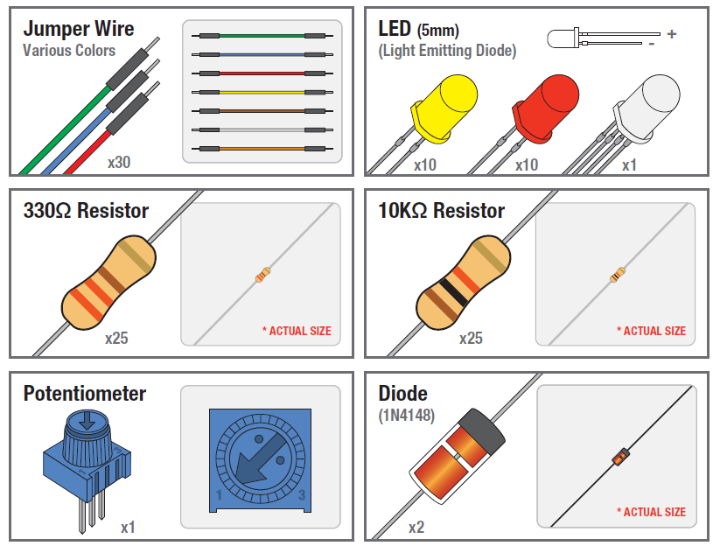
SIK Components

Slide 13
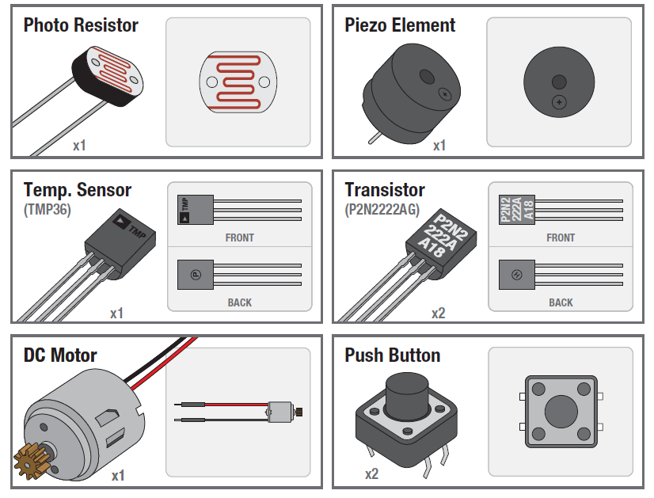
SIK Components

Slide 14
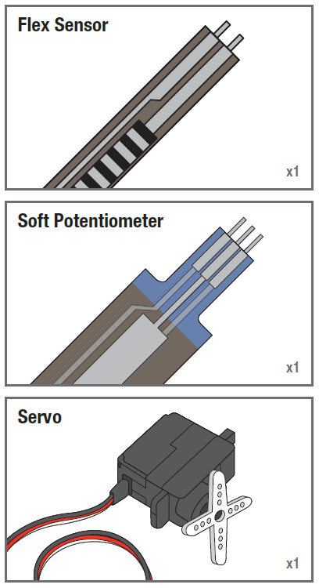
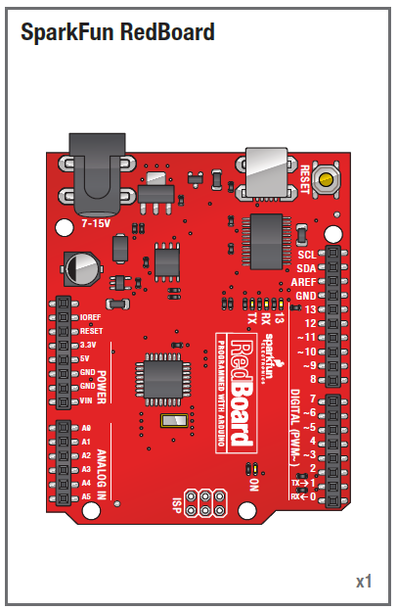
SIK Components

Slide 15
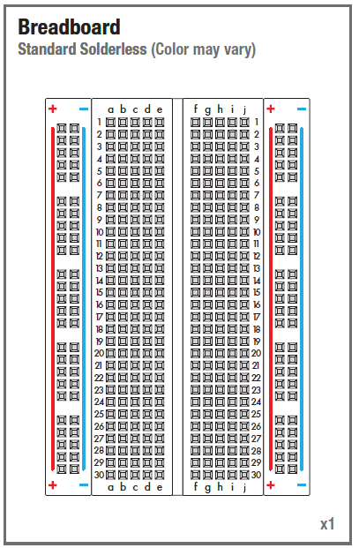
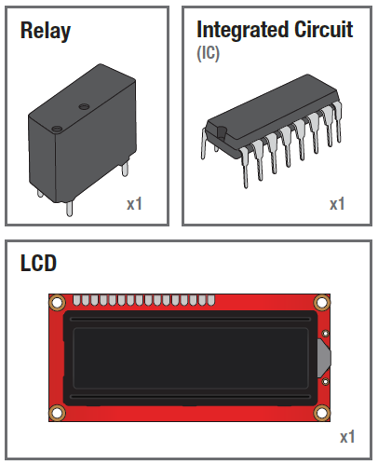

Slide 16
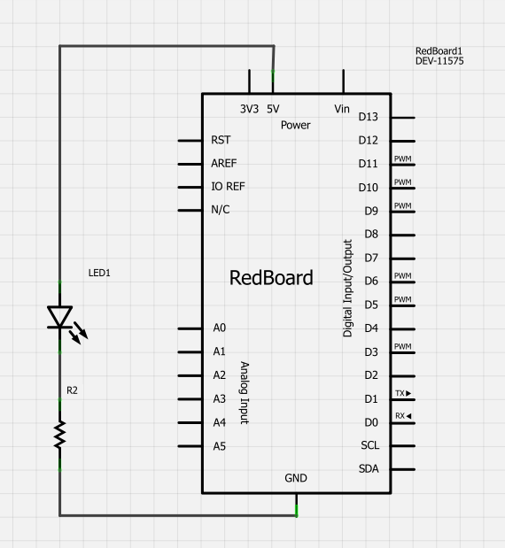
Using the Breadboard to built a simple circuit
Use the breadboard to wire up a single LED with a 330 Ohm Resistor (Orange-Orange-Brown).
Note: the longer leg on the LED is the positive leg and the shorter leg is the negative

Slide 17
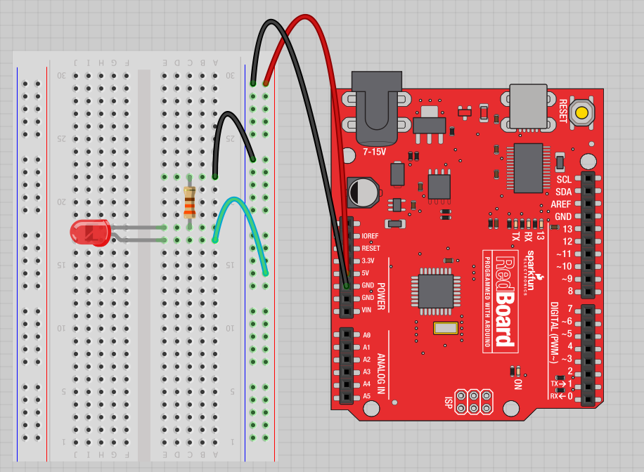
Fritzing View of Breadboard Circuit
What happens when you break the circuit?
What if you wanted to add more than one LED?

Slide 18

Concepts: INPUT vs. OUTPUT
Referenced from the perspective of the microcontroller (electrical board).
Inputs is a signal / information going into the board.
Output is any signal exiting the board.
Almost all systems that use physical computing will have some form of output
What are some examples of Outputs?

Slide 19
Concepts: INPUT vs. OUTPUT
Referenced from the perspective of the microcontroller (electrical board).
Inputs is a signal / information going into the board.
Output is any signal exiting the board.
Examples: Buttons Switches, Light Sensors, Flex Sensors, Humidity Sensors, Temperature Sensors…
Examples: LEDs, DC motor, servo motor, a piezo buzzer, relay, an RGB LED

Slide 20
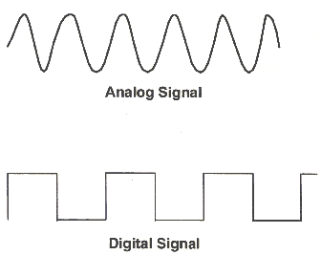
Concepts: Analog vs. Digital
Microcontrollers are digital devices – ON or OFF. Also called – discrete.
analog signals are anything that can be a full range of values. What are some examples? More on this later…
5 V
5 V
0 V
0 V

Slide 21

Open up Arduino
Hints:
For PC Users →
Let the installer copy and move the files to the appropriate locations, or
Create a folder under C:\Program Files (x86) called Arduino. Move the entire Arduino program folder here.
For Mac Users →
Move the Arduino executable to the dock for ease of access.
Resist the temptation to run these from your desktop.

Slide 22
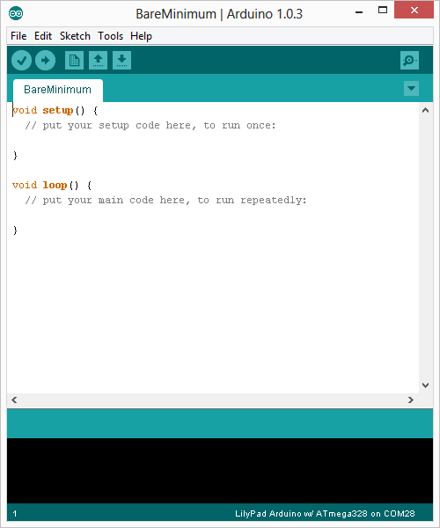
Arduino Integrated Development Environment (IDE)
Two required functions / methods / routines:
void setup()
{
// runs once
}
void loop()
{
// repeats
}
error & status messages
Notes:
Be sure to point out the what all of the buttons do.

Slide 23
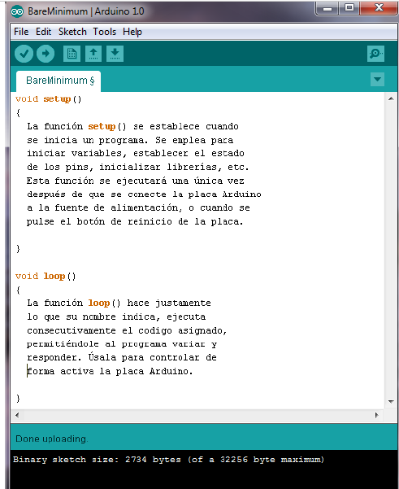
Arduino programming structure

Slide 24
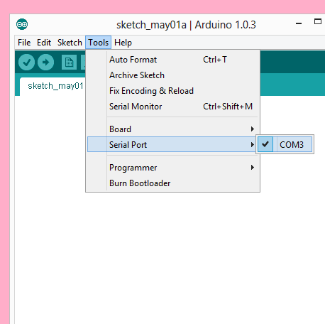
Settings: Tools → Serial Port
Your computer communicates to the Arduino microcontroller via a serial port → through a USB-Serial adapter.
Check to make sure that the drivers are properly installed.
Notes:
All connections to computers- mice, printers etc use a serial port. Gotta pick the right one.

Slide 25
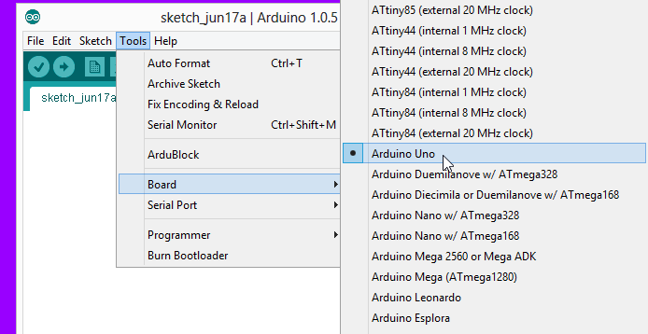
Settings: Tools → Board
Next, double-check that the proper board is selected under the Tools→Board menu.
Notes:
All connections to computers- mice, printers etc use a serial port. Gotta pick the right one.

Slide 26
digitalWrite()
analogWrite()
digitalRead()
if() statements / Boolean
analogRead()
Serial communication
BIG 6 CONCEPTS
This work is licensed under a Creative Commons Attribution-ShareAlike 3.0 United States License.

Slide 27
Let’s get to coding…
Project #1 – Blink
“Hello World” of Physical Computing
Psuedo-code – how should this work?
Turn LED ON
Wait
Turn LED OFF
Wait
Rinse & Repeat

Slide 28
Comments, Comments, Comments
Comments are for you – the programmer and your friends…or anyone else human that might read your code.
// this is for single line comments
// it’s good to put a description at the top and before anything ‘tricky’
/* this is for multi-line comments
Like this…
And this….
*/

Slide 29
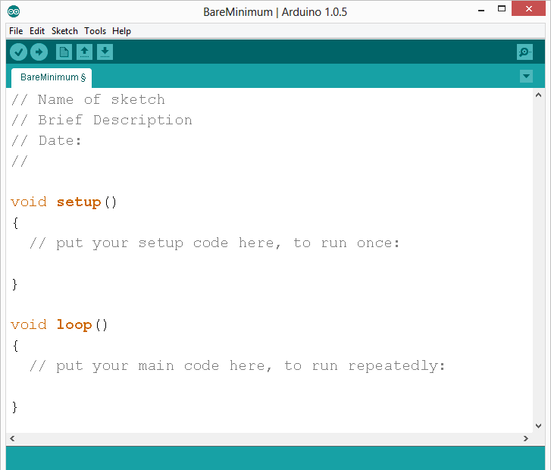
comments
Notes:
Review the two main parts of the sketch – void setup() and void loop()
Provide rationale for good commenting.
Emphasize the need for good / clean coding practices like indenting.

Slide 30
Three commands to know…
pinMode(pin, INPUT/OUTPUT);
ex: pinMode(13, OUTPUT);
digitalWrite(pin, HIGH/LOW);
ex: digitalWrite(13, HIGH);
delay(time_ms);
ex: delay(2500); // delay of 2.5 sec.
// NOTE: -> commands are CASE-sensitive
Notes:
Three commands to rule the world… or at least do 80% of cool Arduino projects.

Slide 31
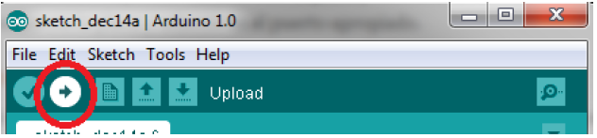
Load the program to the Arduino board

Slide 32
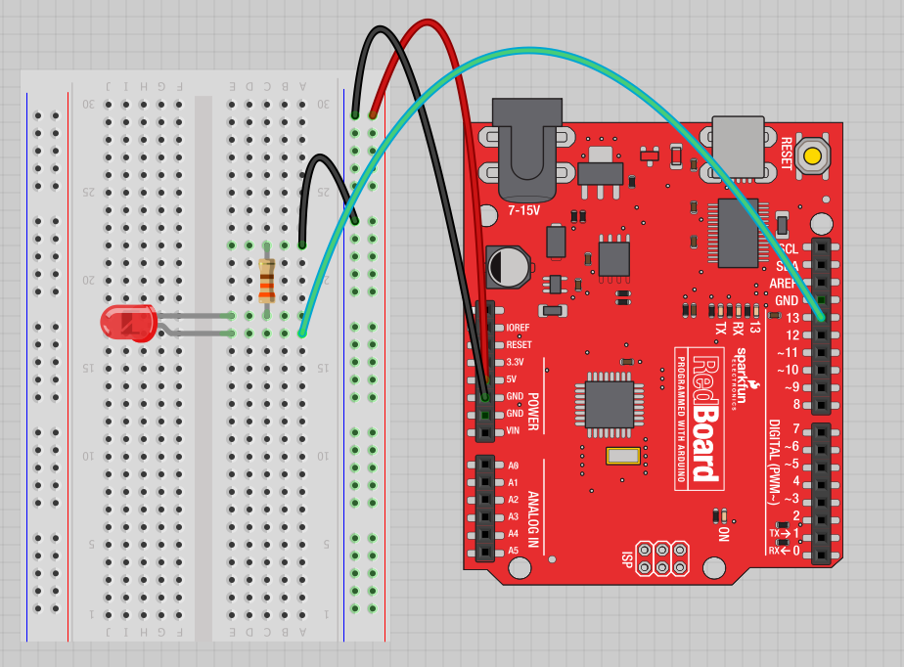
Project #1: Wiring Diagram
Move the green wire from the power bus to pin 13 (or any other Digital I/O pin on the Arduino board.
Image created in Fritzing

Slide 33
A few simple challenges Let’s make LED#13 blink!
Challenge 1a – blink with a 200 ms second interval.
Challenge 1b – blink to mimic a heartbeat
Challenge 1c – find the fastest blink that the human eye can still detect…
1 ms delay? 2 ms delay? 3 ms delay???

Slide 34
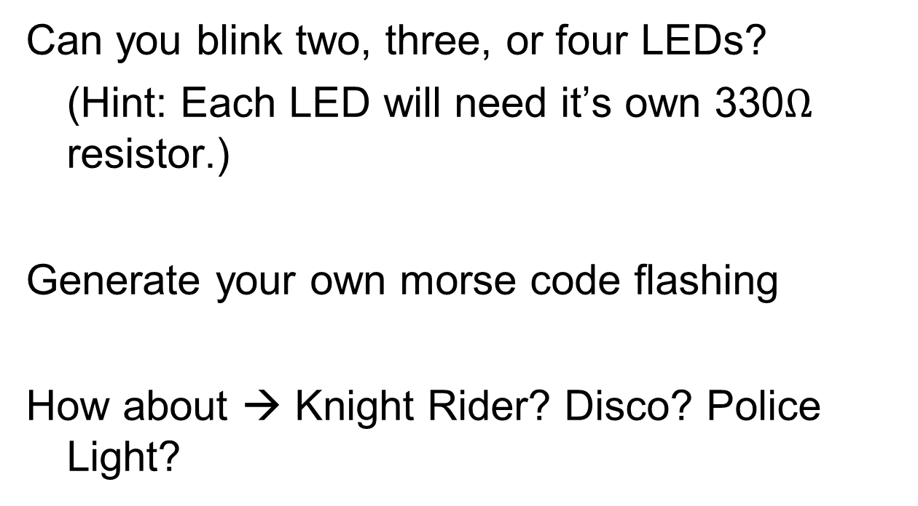
Try adding other LEDs

Slide 35
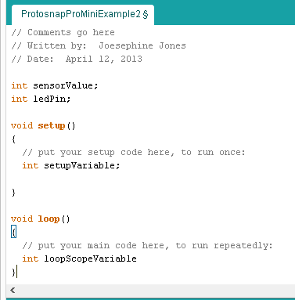
Programming Concepts: Variables
Variable Scope
Global
---
Function-level

Slide 36



Programming Concepts: Variable Types
Variable Types:
8 bits
16 bits
32 bits
byte
char
int
unsigned int
long
unsigned long
float

Slide 37
Fading in and Fading Out (Analog or Digital?)
A few pins on the Arduino allow for us to modify the output to mimic an analog signal.
This is done by a technique called:
Pulse Width Modulation (PWM)

Slide 38
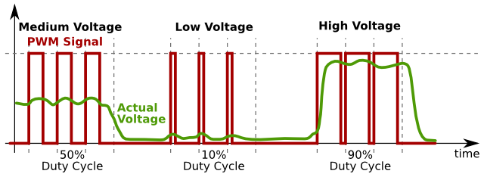
Concepts: Analog vs. Digital
To create an analog signal, the microcontroller uses a technique called PWM. By varying the duty cycle, we can mimic an “average” analog voltage.
Pulse Width Modulation (PWM)

Slide 39

Project #2 – Fading Introducing a new command…
analogWrite(pin, val);
pin – refers to the OUTPUT pin (limited to pins 3, 5, 6, 9, 10, 11.) – denoted by a ~ symbol
val – 8 bit value (0 – 255).
0 => 0V | 255 => 5V

Slide 40
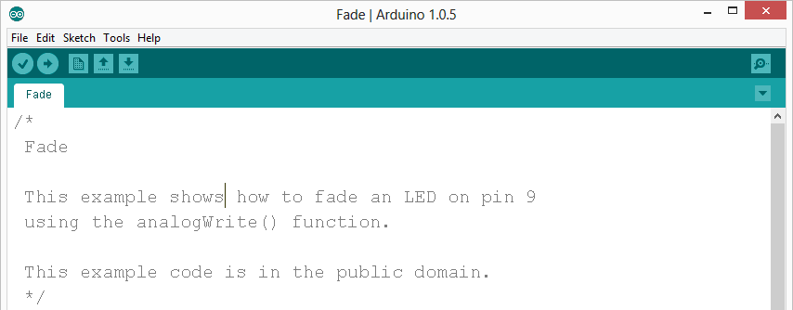
Move one of your LED pins over to Pin 9
In Arduino, open up:
File → Examples → 01.Basics → Fade

Slide 41
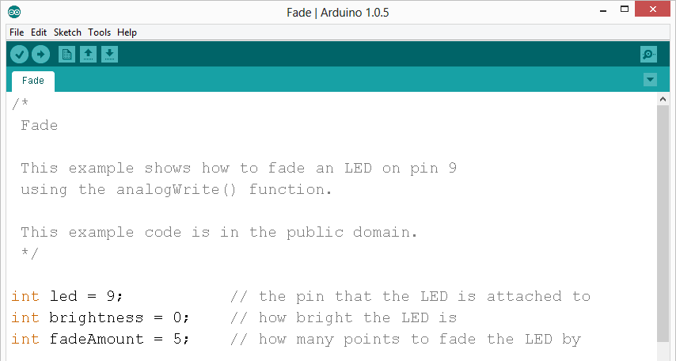
Fade - Code Review

Slide 42
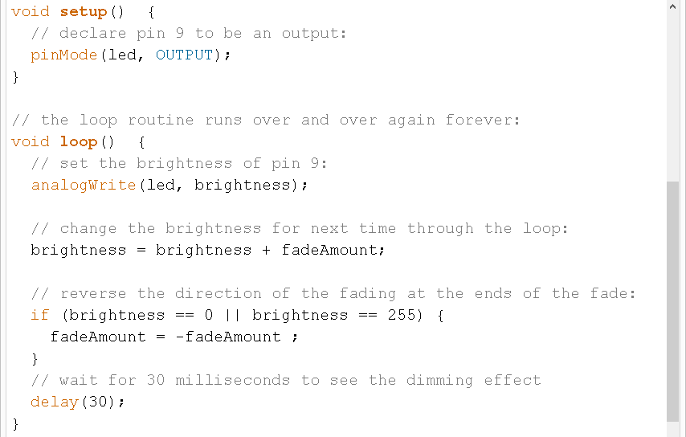
Fade - Code Review

Slide 43
Project# 2 -- Fading
Challenge 2a – Change the rate of the fading in and out. There are at least two different ways to do this – can you figure them out?
Challenge 2b – Use 2 (or more) LEDs – so that one fades in as the other one fades out.

Slide 44
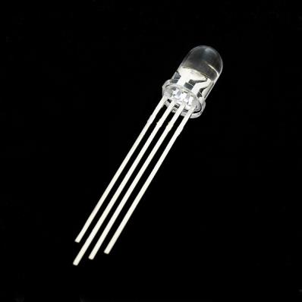
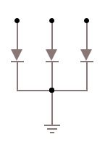
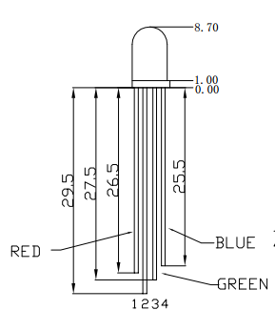
Color Mixing Tri-color LED
R
G
B
In the SIK, this is a standard – Common Cathode LED
This means the negative side of the LED is all tied to Ground.

Slide 45
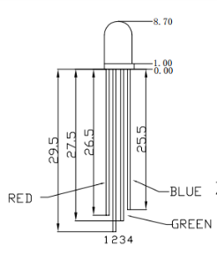
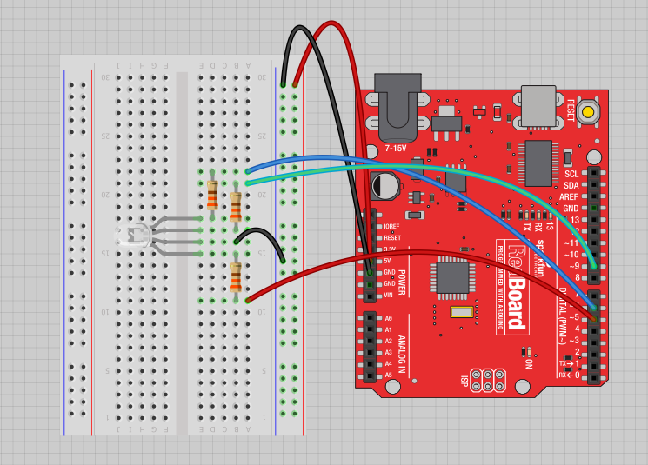
Project 3 – RGB LED
Note: The longest leg of the RGB LED is the Common Cathode. This goes to GND.
Use pins 5, 6, & 9

Slide 46

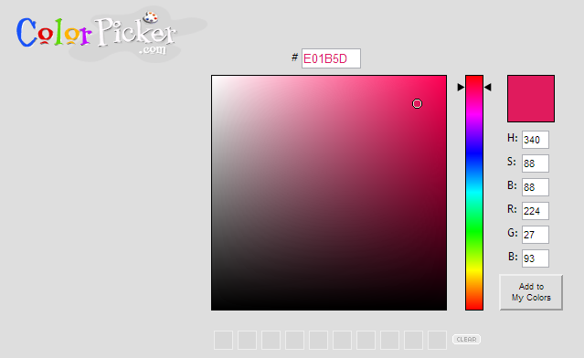
How many unique colors can you create?
Use Colorpicker.com or experiment on your own.
Pick out a few colors that you want to try re-creating for a lamp or lighting display...
Play around with this with the analogWrite() command.

Slide 47
RGB LED Color Mixing
int redPin = 5;
int greenPin = 6;
int bluePin = 9;
void setup()
{
pinMode(redPin, OUTPUT);
pinMode(greenPin, OUTPUT);
pinMode(bluePin, OUTPUT);
}

Slide 48
RGB LED Color Mixing
void loop()
{
analogWrite(redPin, 255);
analogWrite (greenPin, 255);
analogWrite (bluePin, 255);
}

Slide 49


Driving Motors or other High Current Loads
NPN Transistor (Common Emitter “Amplifier” Circuit)
to Digital
Pin 9

Slide 50


Input
Input is any signal entering an electrical system .
Both digital and analog sensors are forms of input
Input can also take many other forms: Keyboards, a mouse, infrared sensors, biometric sensors, or just plain voltage from a circuit

Slide 51
Project #4 – Digital Input
In Arduino, open up:
File → Examples → 02.Digital → Button

Slide 52


Digital Sensors (a.k.a. Switches) Pull-up Resistor (circuit)
to Digital Pin 2

Slide 53


Digital Sensors (a.k.a. Switches) Add an indicator LED to Pin 13
This is just like our 1st circuit!

Slide 54
Digital Input
Connect digital input to your Arduino using Pins # 0 – 13 (Although pins # 0 & 1 are also used for programming)
Digital Input needs a pinMode command:
pinMode (pinNumber, INPUT);
Make sure to use ALL CAPS for INPUT
To get a digital reading:
int buttonState = digitalRead (pinNumber);
Digital Input values are only HIGH (On) or LOW (Off)
Notes:
Put together circuit # 7 and leave in

Slide 55
Digital Sensors
Digital sensors are more straight forward than Analog
No matter what the sensor there are only two settings: On and Off
Signal is always either HIGH (On) or LOW (Off)
Voltage signal for HIGH will be a little less than 5V on your Uno
Voltage signal for LOW will be 0V on most systems

Slide 56

http://opensourcehardwarejunkies.com/tutorial-03-digitalread-and-serial-port-communication/

Slide 57

Programming: Conditional Statements if()

Slide 58

Programming: Conditional Statements if()
void loop()
{
int buttonState = digitalRead(5);
if(buttonState == LOW)
{ // do something
}
else
{ // do something else
}
}
DIG INPUT

Slide 59
Boolean Operators
<Boolean> | Description
( ) == ( ) | is equal?
( ) != ( ) | is not equal?
( ) > ( ) | greater than
( ) >= ( ) | greater than or equal
( ) < ( ) | less than
( ) <= ( ) | less than or equal

Slide 60

Trimpot (Potentiometer) Variable Resistor
fixed
end
wiper
fixed
end

Slide 61



Analog Sensors 3 Pin Potentiometer = var. resistor (circuit) a.k.a. Voltage Divider Circuit
wiper
fixed
ends
1.0 V
1.0 V

Slide 62
analogRead()
Arduino uses a 10-bit A/D Converter:
this means that you get input values from 0 to 1023
0 V → 0
5 V → 1023
Ex:
int sensorValue = analogRead(A0);

Slide 63

analogRead()

Slide 64




Using Serial Communication
Method used to transfer data between two devices.
Data passes between the computer and Arduino through the USB cable. Data is transmitted as zeros (‘0’) and ones (‘1’) sequentially.
Arduino dedicates Digital I/O pin # 0 to receiving and Digital I/O pin #1 to transmit.
Notes:
For this reason, we typically do not use Digital I/O 0 or 1 for anything in our designs.

Slide 65

Serial Monitor & analogRead()
Initializes the Serial Communication
9600 baud data rate
prints data to serial bus

Slide 66
Serial Monitor & analogRead()
Opens up a Serial Terminal Window

Slide 67





Analog Sensors 2 Pin Analog Sensors = var. resistor
Take two sensors -- Use the Serial Monitor and find the range of input values you get for each sensor.
MaxAnalogRead = _________
MinAnalogRead = _________

Slide 68
Analog Sensors
Examples:
Sensors | Variables
Mic | soundVolume
Photoresistor | lightLevel
Potentiometer | dialPosition
Temp Sensor | temperature
Flex Sensor | bend
Accelerometer | tilt/acceleration

Slide 69
Additional Serial Communication Sending a Message
void loop ( )
{
Serial.print(“Hands on “) ;
Serial.print(“Learning ”) ;
Serial.println(“is Fun!!!”) ;
}

Slide 70


Slide 71

Serial Communication: Serial Debugging
void loop()
{
int xVar = 10;
Serial.print ( “Variable xVar is “ ) ;
Serial.println ( xVar ) ;
}

Slide 72

Serial Communication: Serial Troubleshooting
void loop ( )
{
Serial.print (“Digital pin 9: “);
Serial.println (digitalRead(9));
}

Slide 73

Questions?

